Slide 1
Todays Overview
Group session (with Philipp)
Recap last session
Looking into phage genome annotations
Finish first part (Prophage annotation)
CRISPR-cas introduction
Run CRISPRcasFinder
CAS-cluster annotation (subgroup work)
Outlook for next week

Slide 2
Recap last session

Slide 3
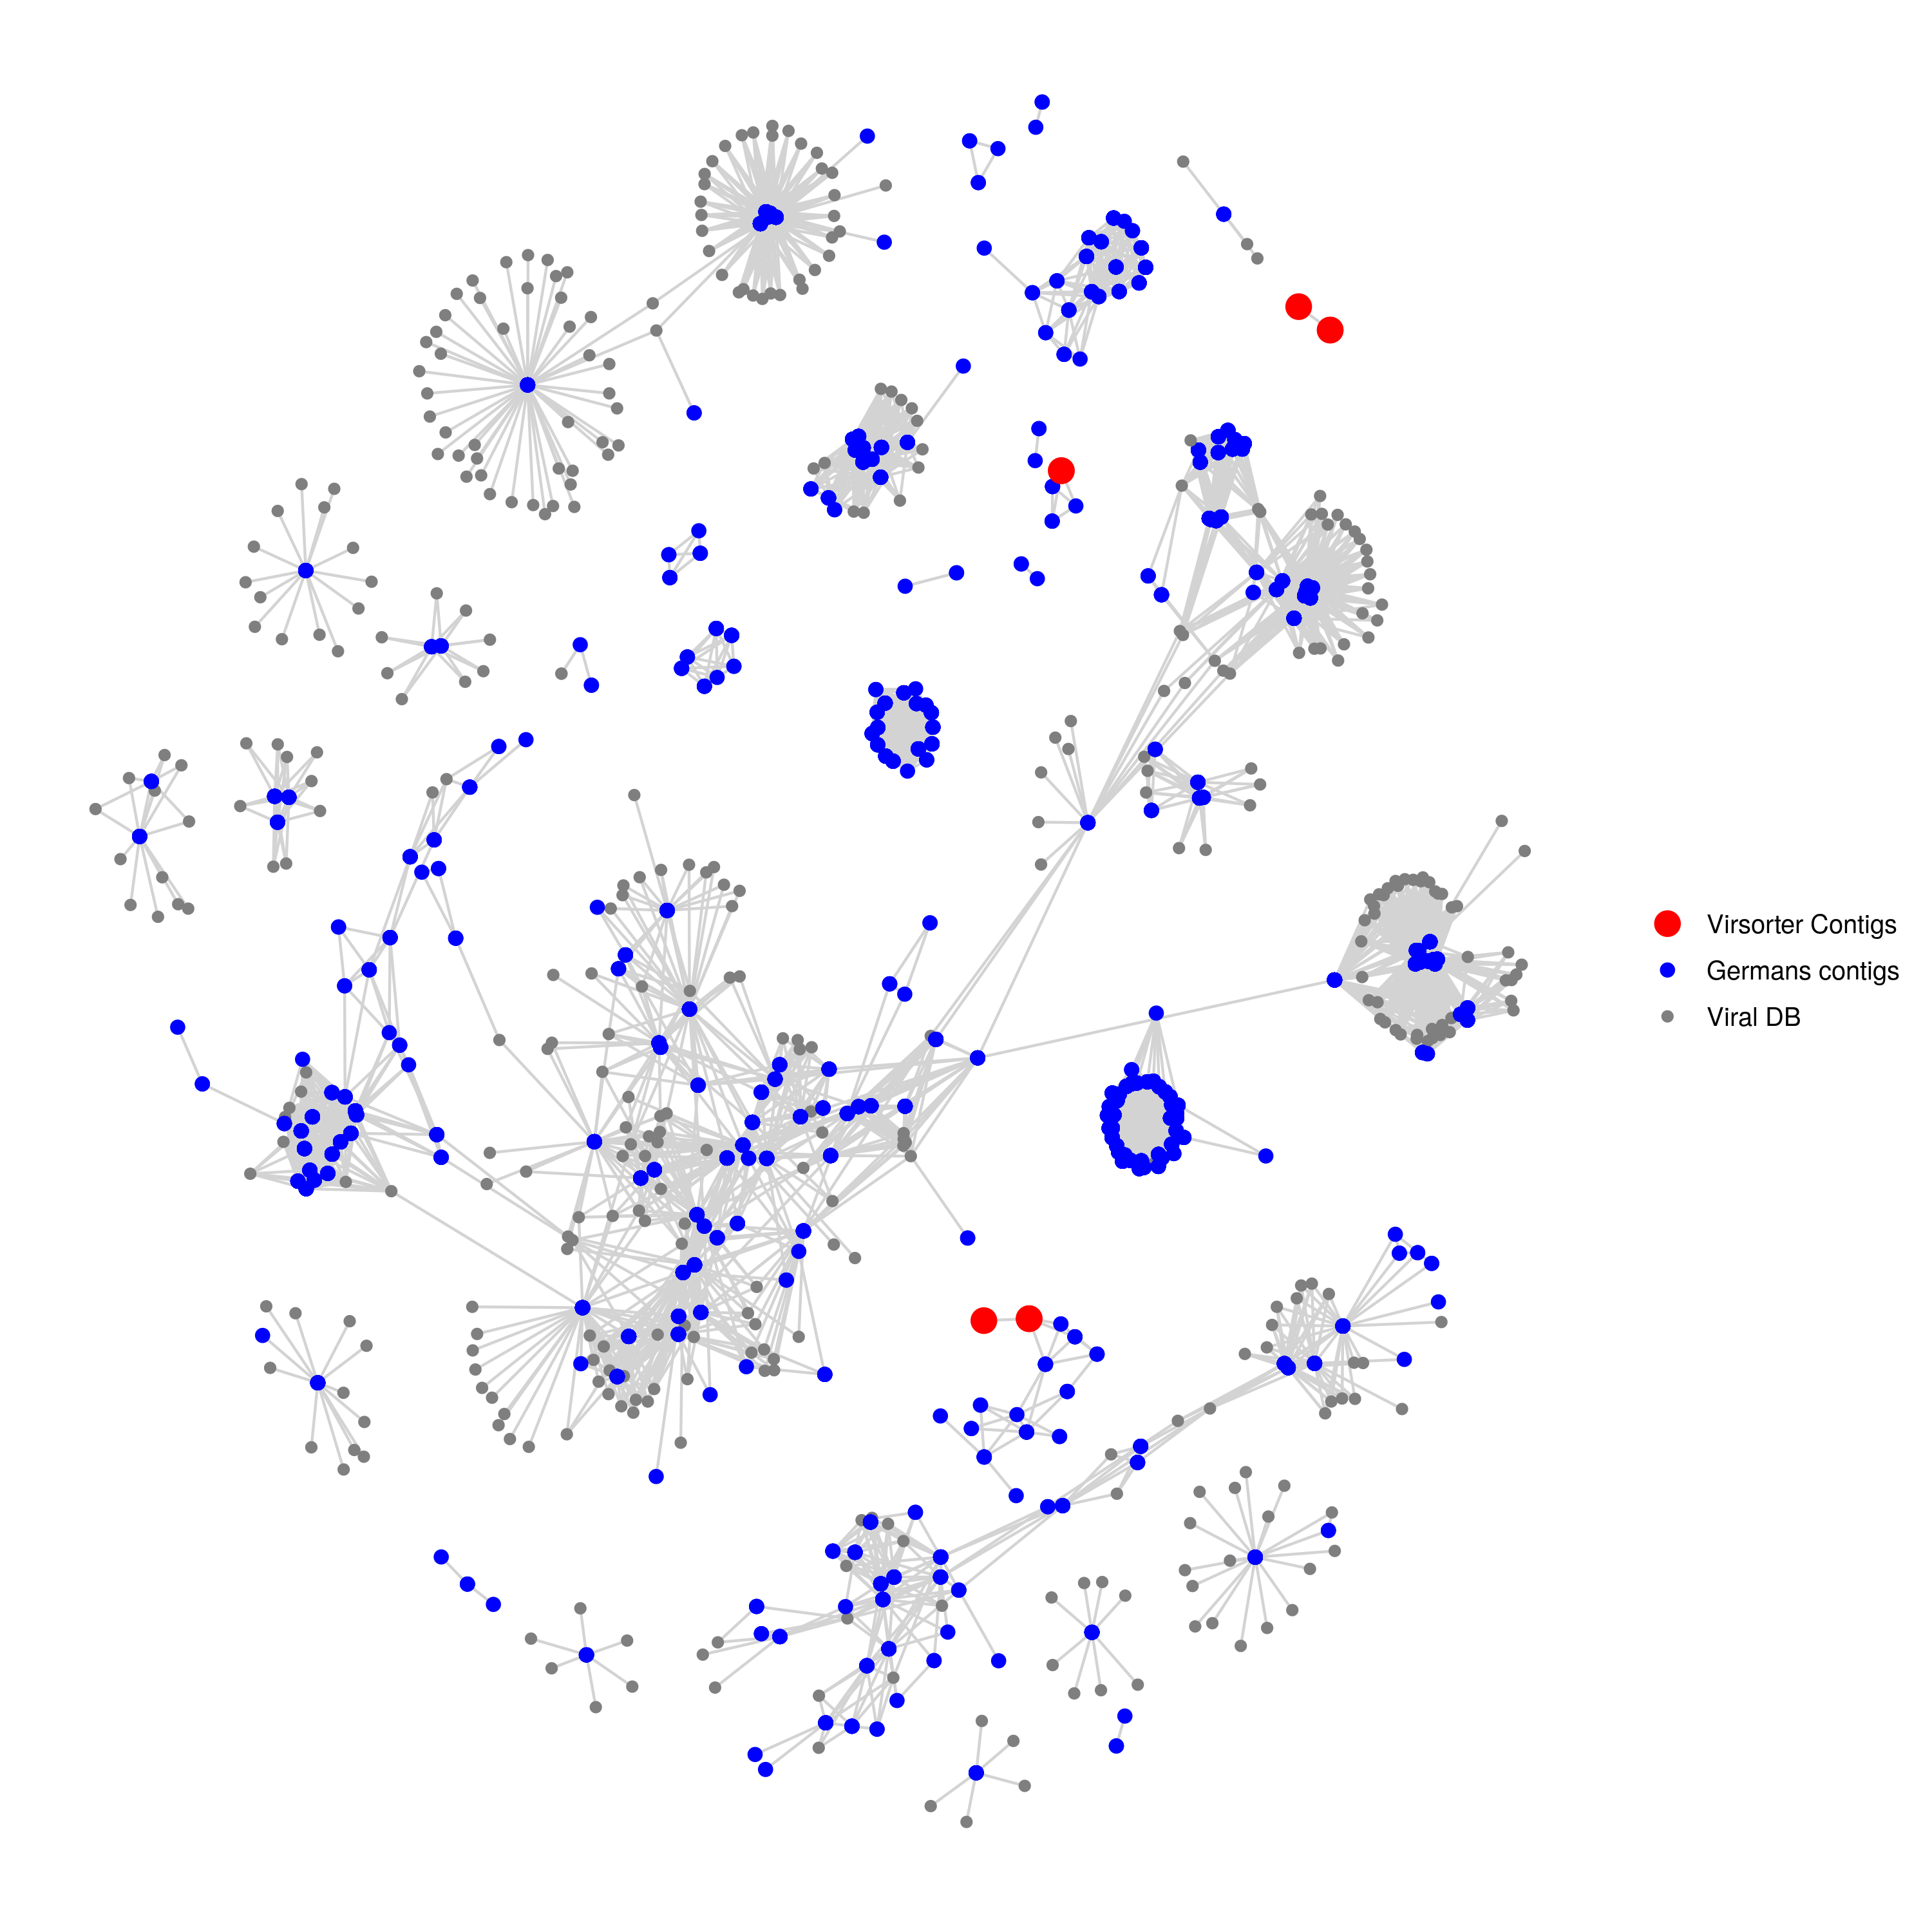
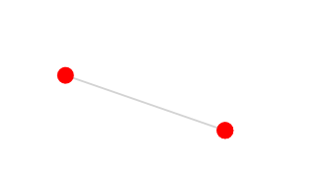
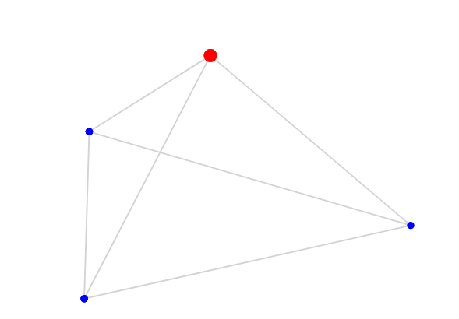
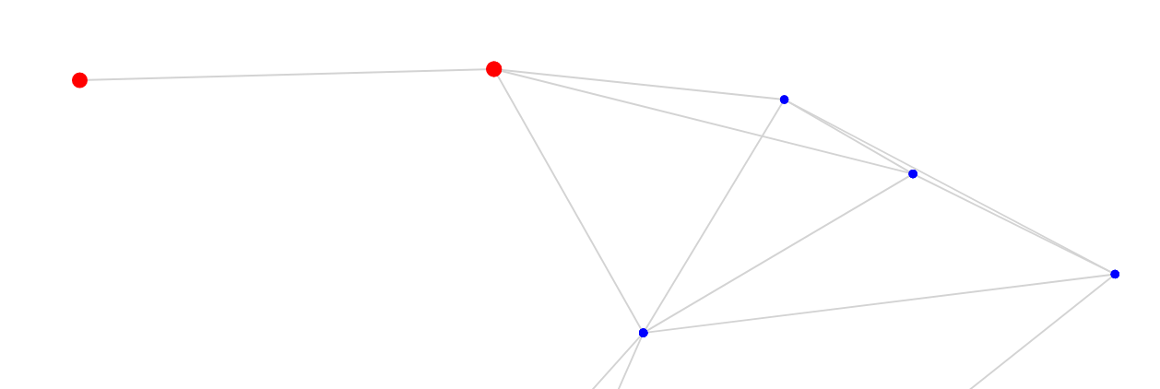
Phagen network
category 3 (not so sure)
Ga0401710_02
Ga0401713_04
Ga0401710_01
Siphoviridae of Type1
category 2 (somewhat sure)
Siphoviridae of Type1
Ga0401713_02
Ga0401715_02
Missing:
category 2 (somewhat sure)
Ga0401710_03

Slide 4
Phagen network
category 3 (not so sure)
Ga0401710_02
Ga0401713_04
Ga0401710_01
Siphoviridae of Type1
category 2 (somewhat sure)
Siphoviridae of Type1
Ga0401713_02
Ga0401715_02
Missing:
category 2 (somewhat sure)
Ga0401710_03

Slide 5
Next steps
You can explore the network
You have the HTML file or code (github)
Which genomes co-cluster (NCBI)
Alignment of the clustering phages
With mauve you could see shared genes
http://darlinglab.org/mauve/mauve.html

Slide 6
Github (https://github.com/Freevini/SAGE2_Phages)
Version control tool
Keeping track of your code
Collaboration
interaction
Download the directory or look online.
Comment (issues)
Change and submit code yourself!

Slide 7
Looking into phage genome annotations
What do you have?
Where do you have problems?
What do you want to do?

Slide 8
Finish first part (Prophage annotation)
What did we do?
What do you want to show?
What still needs to be done?

Slide 9

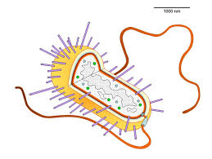
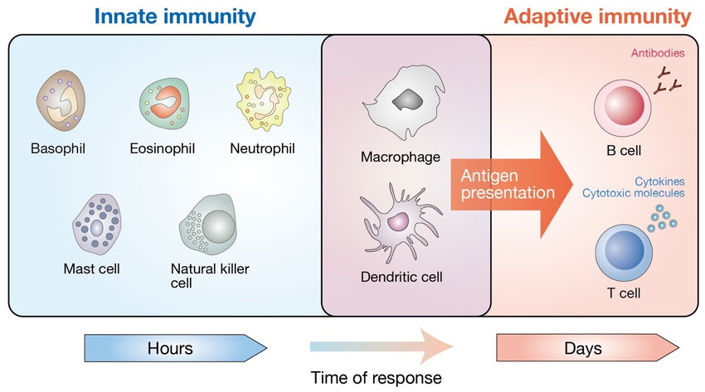
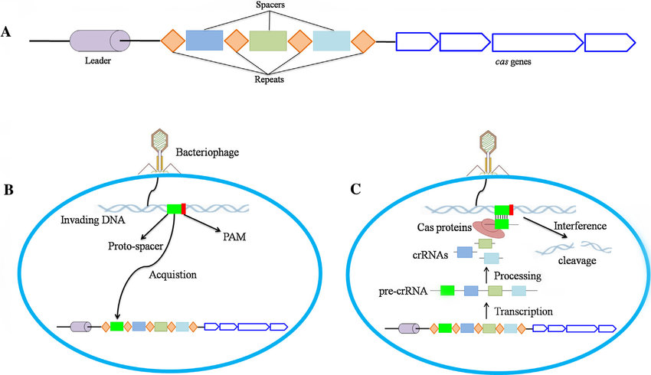
CRISPR-cas: The immunsystem of bacteria

Slide 10
What is needed for a adaptive immune system
Can recognise unwanted
Can destroy/kill unwanted
Can change/adapt to encounters
Can distinguish between self/non-self
...

Slide 11
CRISPR-cas system components
CRISPR array
Cas-cluster
(anti-CRISPR on the phage side)

Slide 12
CRISPR-cas system components
CRISPR array
Spacers are the actual matching regions against the “phages”
Repeats are the flanking regions that divide the spacers

Slide 13
CRISPR-cas system components
Cas-cluster
Cas-genes are the actual scissors. The cleave the targeted “phage” region.
There is a big diversity of Cas-genes. This are used to identify the CRISPR type.

Slide 14
Three crucial steps in CRISPR-cas
Acquisition
Expression
Intereference
(…spacer remove)

Slide 15
Three crucial steps in CRISPR-cas
Acquisition
- Detection of free DNA (ssDNA or dsDNA) by Cas-gene
- Identification of Protospacer adjacent Motif (PAM). Short motif to distinghish between self and non-self.
- Insertetion into the genome from the leader side (CRISPR spacer directionality)

Slide 16
Three crucial steps in CRISPR-cas
Expression
- transcription (to RNA) of CRISPR array.
- Processing to single CRISPR spacers crRNAs
- searching for matching regions

Slide 17
Three crucial steps in CRISPR-cas
Intereference
- detection and matching to protospacer and PAM.
- combining with Cas-proteins
- interference by cleavage
Why no self recognitation?

Slide 18
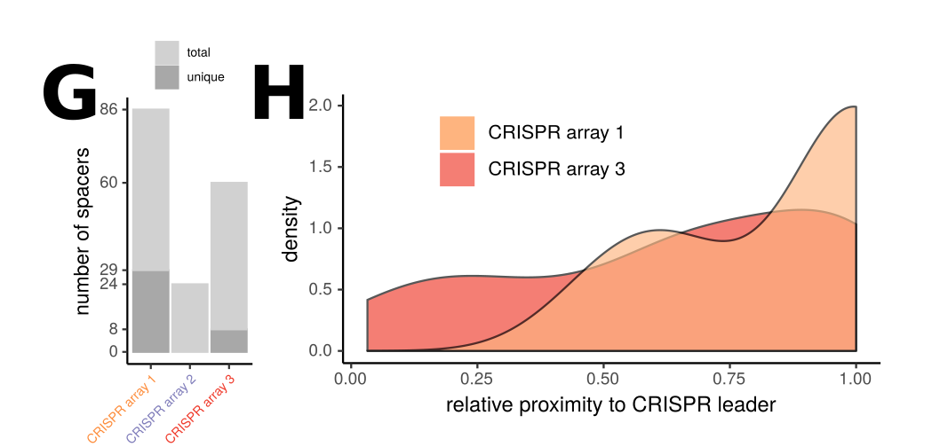
Three crucial steps in CRISPR-cas
…spacer remove
Unique spacers = more recent spacers

Slide 19
CRISPR-cas system
CRISPR array
Cas-cluster
(anti-CRISPR on the phage side)

Slide 20
How can we detect CRISPR-cas genes
Look at genome annotation
For Cas, csn, csm (e.g. with grep)
Use specialised command line tools.
PilerCR (looks for palindromic repeats)
Use online tool
CRISPRmap
CRISPRcasfinder

Slide 21
CRISPRcasfinder
Useful online tool to detect CRISPR arrays and CAS-genes
Extensive database for typing and subtyping
https://crisprcas.i2bc.paris-saclay.fr/
Try it out with the Bacterialgenomes

Slide 22
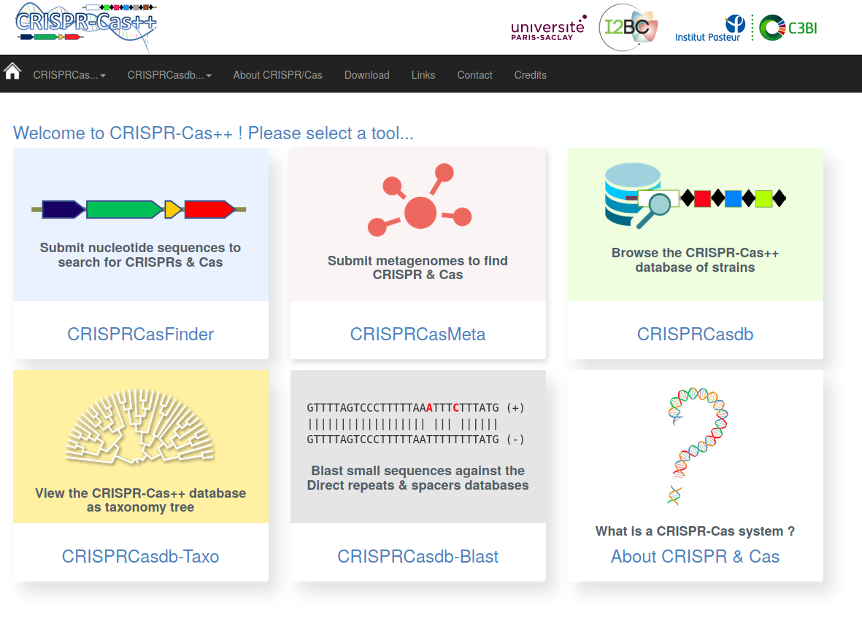
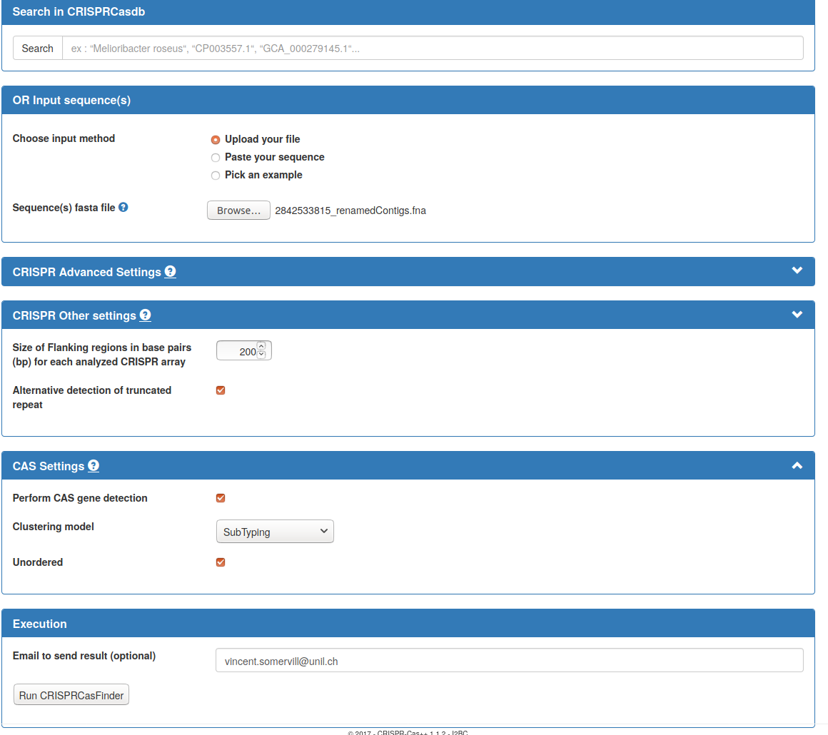
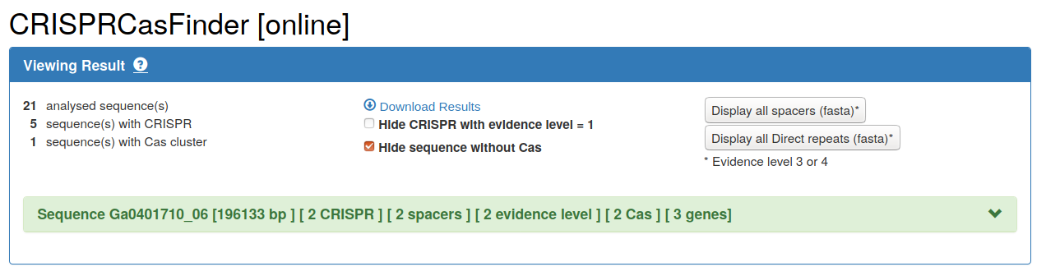
How to CRISPRcasfinder?
1
2
Submit the bacterial
contigs
200bp
tick
tick
subtyping
3
tick
Hide sequence without Cas
Email adresse

Slide 23
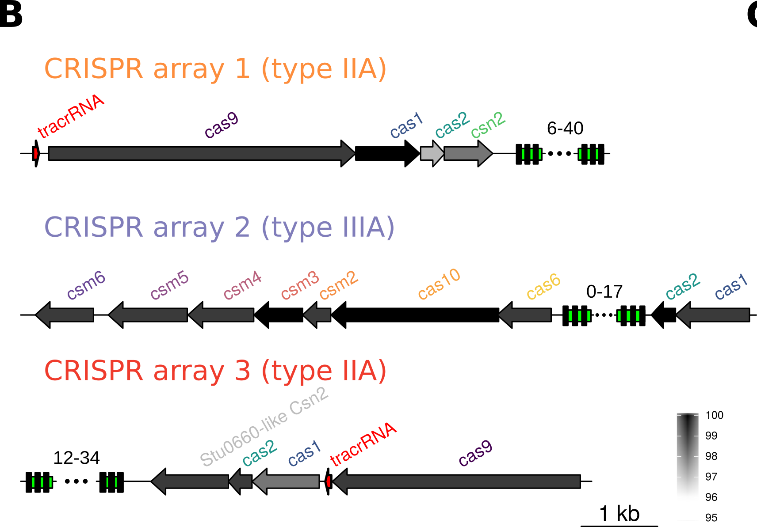
Make a figure of your Cas-genes
- download the CRISPRcasfinder output files
- Reuse your R code from the prophage annotation to creat an image

Slide 24
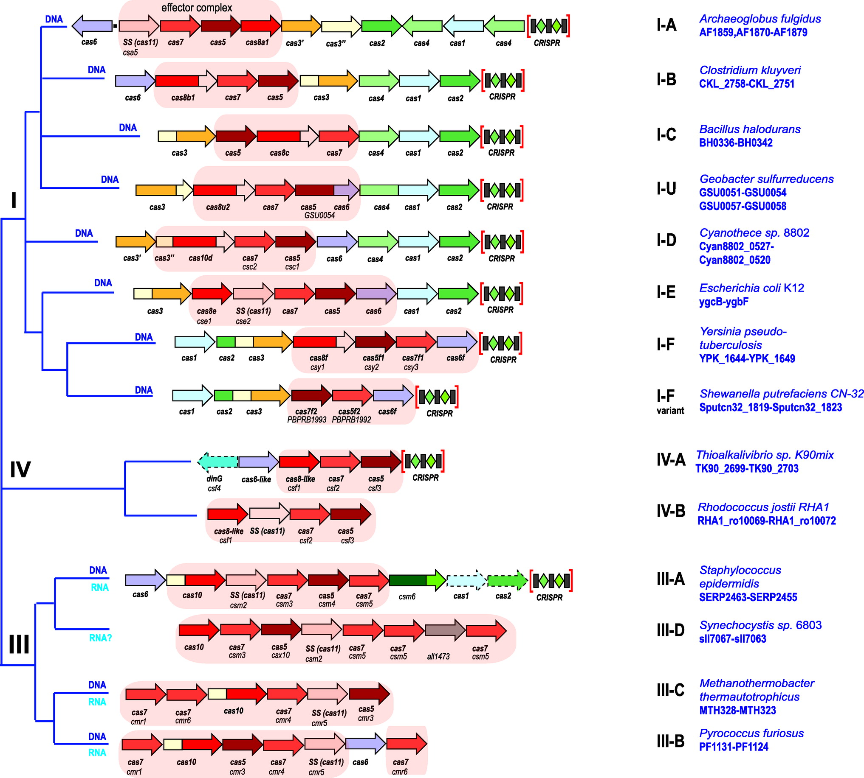
Outlook for next week
Identify our CRISPR types by comparing to literature
Learn more about bifidobacterium CRISPR
Spacer analysis

Slide 25
Course overview
Gene and phage annotation (31.3)
Phage taxonomy (21.4)
CRISPR arrays, repeats and Cas-genes (28.4)
CRISPR-/Proto-spacer (5.5)
CRISPR-/Proto-spacer (12.5)

Slide 26
Todays Overview
Group session (with Philipp) +short presentation
Feedback and ideas for presentation
CRISPR-cas types of our Bifido
CRISPR spacers
Outlook for next week

Slide 27
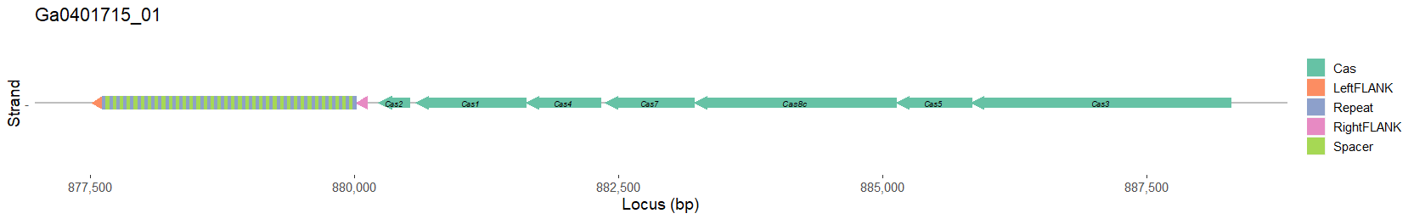
CRISPR-cas types of our Bifido
- Look into the script of Vincent De Bakker to understand how to do this.
- go into literature to identify what the Cas-genes do
- by name
- or by paperblast

Slide 28
CRISPR spacers
1. Acquisition of new spacers
2. Defense against previously encountered phages
CRISPRs give us an image of the phages in the system

Slide 29
What can we do with the CRISPR spacers

Slide 30
What can we do with the CRISPR spacers
Blast
What phages were encountered
Doe we have other mappings then phages
Do we have spacer redundancy?
The strains share spacers?
Topology?
CRISPR spacer turnover rate?
What is the ordering of the spacers?
From old to new?

Slide 31
How can we extract the CRISPR spacers from CRISPRcas Finder
https://github.com/Freevini/SAGE2_Phages

Slide 32
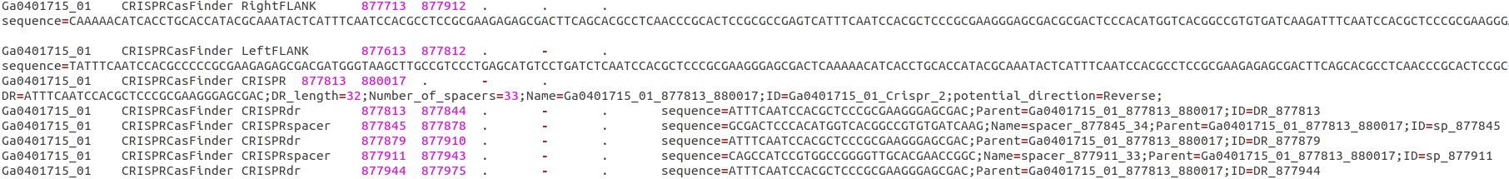
How can we extract the CRISPR spacers from CRISPRcas Finder
https://github.com/Freevini/SAGE2_Phages
1. Look into the *.gff files in the GFF folder

Slide 33
How can we extract the CRISPR spacers from CRISPRcas Finder
https://github.com/Freevini/SAGE2_Phages
1. Look into the *.gff files in the GFF folder
2. extract sequences of spacers

Slide 34
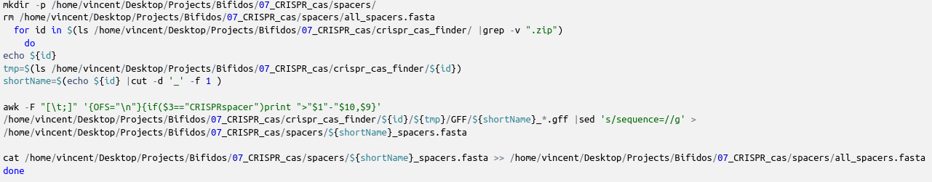
How can we extract the CRISPR spacers from CRISPRcas Finder
https://github.com/Freevini/SAGE2_Phages
1. Look into the *.gff files in the GFF folder
2. extract sequences of spacers

Slide 35
How can we extract the CRISPR spacers from CRISPRcas Finder
https://github.com/Freevini/SAGE2_Phages
1. Look into the *.gff files in the GFF folder
2. extract sequences of spacers

Slide 36
What do we do first?

Slide 37
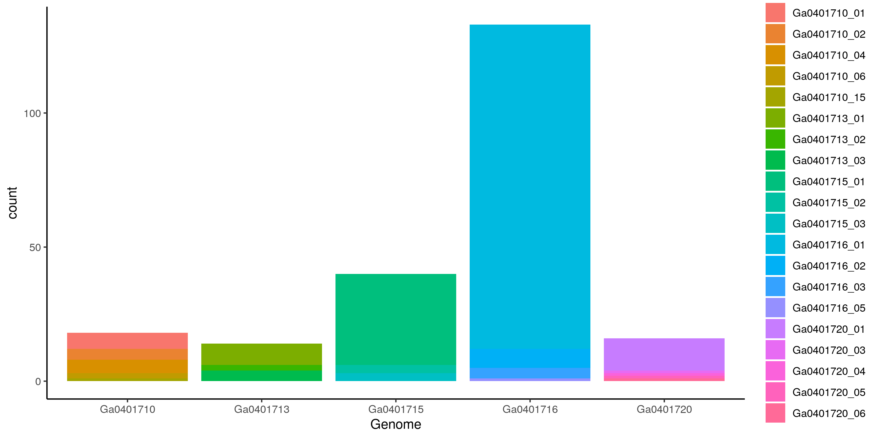
What do we do first?
e.g. How many spacers do we have?

Slide 38
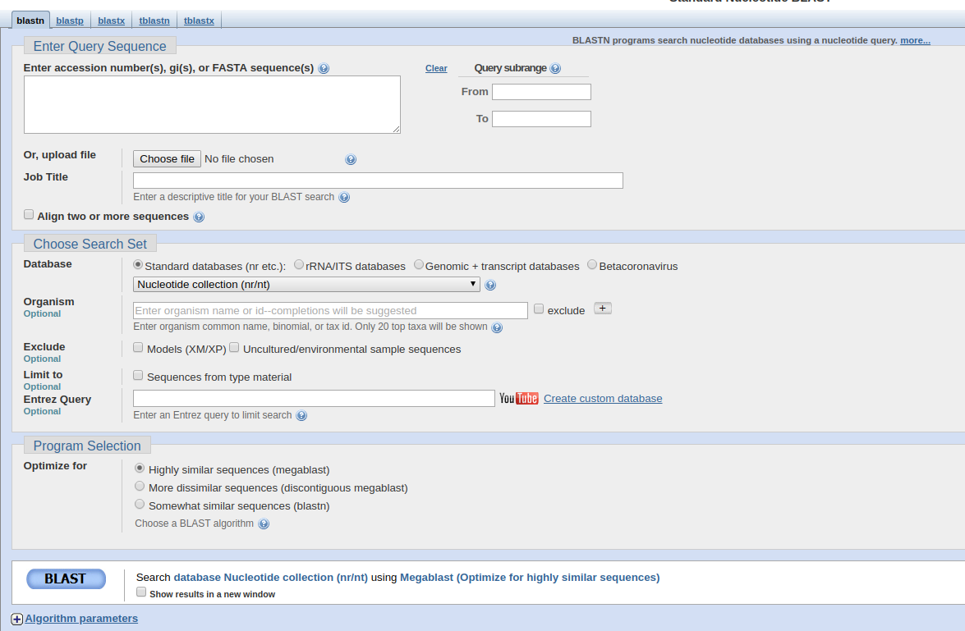
Blast online?
Different algorithms
Manually add fasta sequence
Upload a multisequence file
Align against an own reference
Database (genes or genomes)
Only against a specific taxon
Program selection
Tick if you want to do multiple alignments
(new tab opens)

Slide 39
What can we blast against?

Slide 40
What can we blast against?
- virus DB
- nucleotide DB
- own Viruses
- own Genome
- plasmids

Slide 41
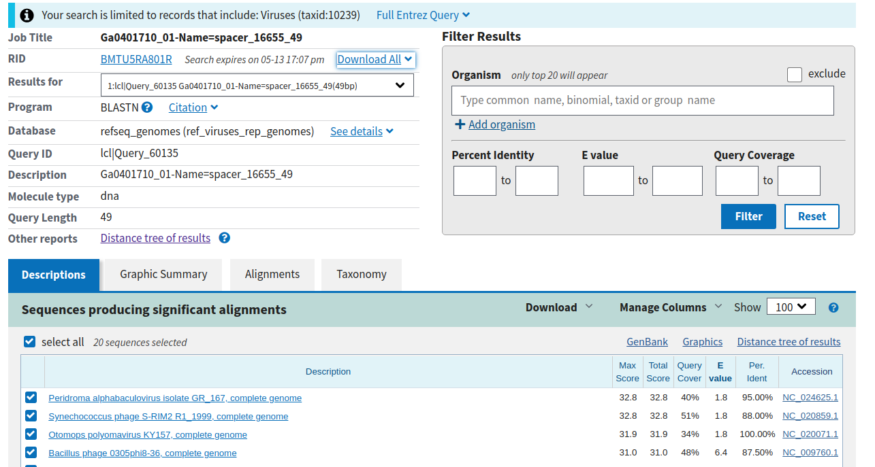
Blast outpu
How to read the report?
Download Hit table (csv)
Download Hit table (csv)
Choose different outputs
filter
Choose visualisation
See where the mapping was

Slide 42
Download an handle in R
- How do we filter?
- what is an e value?
FAQ:https://blast.ncbi.nlm.nih.gov/Blast.cgi?CMD=Web&PAGE_TYPE=BlastDocs&DOC_TYPE=FAQ

Slide 43
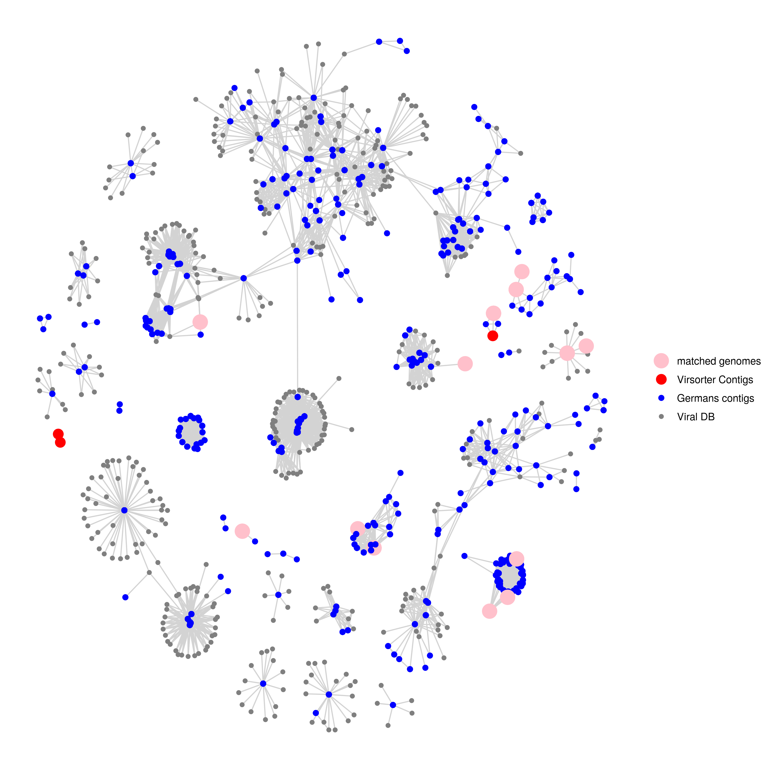
Finally put into classification

Slide 44
Finally put into classification

Slide 45
The end session 3

Slide 46
preperation

Slide 47
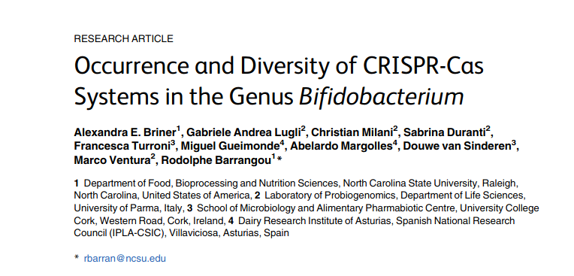
NUPACK was used to generate RNA folding prediction images
CRISPR types in Bifidobacterium
Bifidobacteriumspecieshave a very high frequency of CRISPR-Cas occurrence (77%, 37 of 48).
Type designation was confirmed by the presence ofcas3,cas9, andcas10forType I, II, and III respectively.
CRISPR spacers in bifidobacteria show perfect homology toprophage sequences harbored in the chromosomes of other species ofBifidobacterium,including some spacers that self-target the chromosome.
https://www.ncbi.nlm.nih.gov/pmc/articles/PMC4521832/pdf/pone.0133661.pdf

Slide 48
How do you get phage DNA

Slide 49
What is known about Bifido phages?

Slide 50
CRISPR-cas intro
https://www.ncbi.nlm.nih.gov/pmc/articles/PMC5901762/
Cas3 in type I systems, Cas9 in type II, and Cas10 in type III (Evolution and classification of the CRISPR-Cas systems)
Type II CRISPR-Cas systems are currently classified into three subtypes (II-A, II-B, and II-C), two of which were introduced in the updated classification
Type II-A systems encompass an additional gene, known as csn2

Slide 51
